Slide 1
Material Editing in Complex Scenes by Surface Light Field Manipulation and Reflectance Optimization
Chuong H. Nguyen | Daniel Scherzer
Tobias Ritschel | Hans-Peter Seidel
Max-Planck-Institut Informatik

Slide 2
Motivation – A Canvas for Material Design
Notes:
In this work, we propose a system for material design for scene with spatially varying material, complex geometry under global illumination settings. Our system allows an artist performing interactive appearance manipulation by painting strokes onto a “3D” canvas and get the feedback in real-time

Slide 3
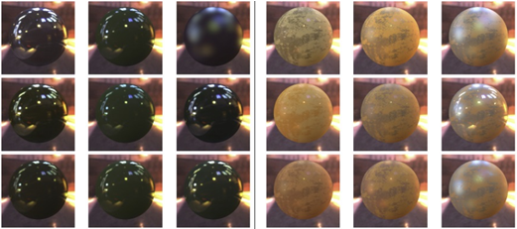
Background – Material Editing Study
Kerr et al: Toward Evaluating Material Design Interface Paradigms for Novice Users , SIGGRAPH 2010
Nguyen et al: 3D Material Style Transfer, EUROGRAPHICS 2012
Notes:
In a recent study of material editing interface, Kerr point out the difficulty in finding the right color in material editing, especially under colored lighting and that editing color in material editing from setting color in image editing is different.
In last year, in the user study for 3d material style transfer from image to a 3d scene. Our subjects comment out the difficulty in finding the right color that match the pre-defined color. This motivate us for a better scheme to editing color in material editing.

Slide 4
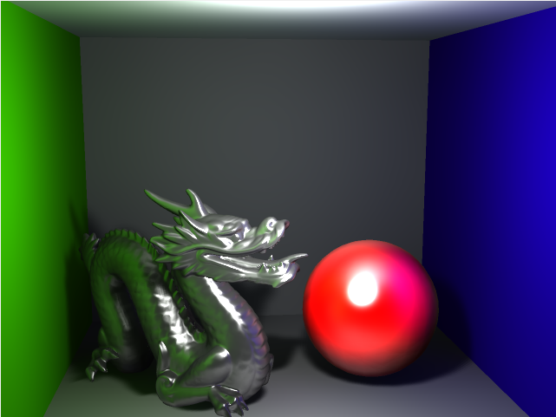
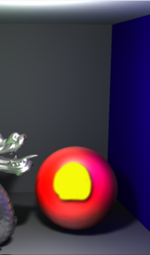
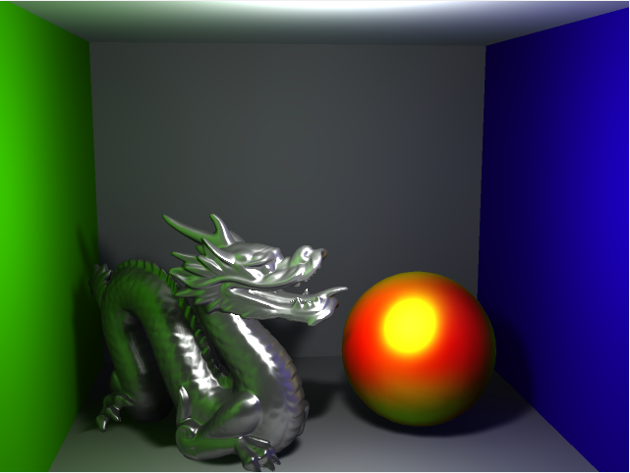
Motivation
Input Scene
Target
Optimized reflectance
Notes:
From these observation, we propose a system for a more intuitive editing to control material color appearance.
In our system, given an input scene, and a defined target color at certain places of the scene
The goal is to find the material that satisfy the appearance at these constrained places

Slide 5
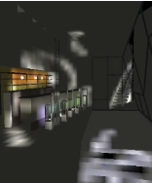
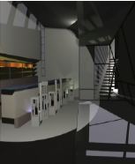
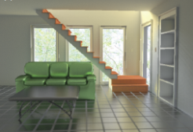
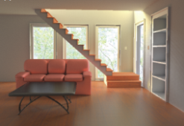
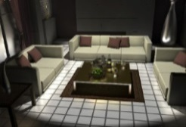
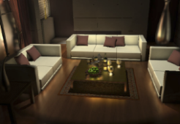
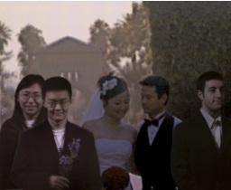
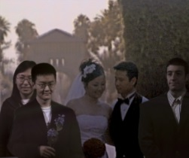
Previous Works
Inverse Lighting
Schoeneman et al: Painting with Light, SIGGRAPH 1993
Kawai et al: Radioptimization – Goal Based Rendering, SIGGRAPH 1993
Pellacini et al: A User Interface for Interactive Cinematic Shadow Design, SIGGRAPH 2002
Material Editing
Ben-Artzi et al: A Precomputed Polynomial Representation for Interactive BRDF Editing with Global Illumination, TOG 2008
Nguyen et al: A PCA Decomposition for Real-time BRDF Editing and Relighting with Global Illumination, EGSR 2010
Edit Propagation
Pellacini et al: AppWand: Editing Measured Materials using Appearance Driven Optimization, SIGGRAPH 2007
Light-field Editing
Horn et al: LightShop: Interactive Light Field Manipulation and Rendering, I3D 2007
Notes:
There are some related direction that are similar to our work
Inverse lighting problem tries to optimize for light settings that satisfy a user-constraints. Even though somewhat similar, our work is dealing with material.
Interactive material editing with global illumination allow interactive feedback of material using long precomputation time. In constrast to these work, our system used precomputed visitiblity based on a gpu implementation, which has fast precomputation time.
Appwand perform edits in appearance space and propagate edit into similar position, an idea that we generalize by taking illuminant and geometry into account when propagating edits.
Light field can be combined and displayed interactively, but these are not physically meaningful and can not be used in every rendering system

Slide 6
Definition
Input Scene
Incoming light
Surface light field
$$L_{i}$$
$$F_{0}$$
Notes:
First, there are some fundamental definition of our work.
Given a 3D scene and its 2D representation
Consider a point, on the red sphere. Incoming illumination at this point on the upper hemisphere is represent by a 2D microbuffer.
With the BRDF of a certain outgoing direction and the incoming light, the outgoing radiance at that t. A surface light field encode the outgoing radiance from a set of outgoing direction

Slide 7
Problem statement
Input Scene
$$L_{i}$$
?
BRDF
New BRDF
SLF
Manipulation
SLF
New SLF
$$F_{0}$$
$$F$$
Notes:
Given an input scene. Consider a point on the sphere, the incoming illumination is defined as a 2d texture.
Consider the current brdf , produce the out going SLF.
SLF is manipulated into new SLF , we try to find a new brdf that best match the new surface light field

Slide 8
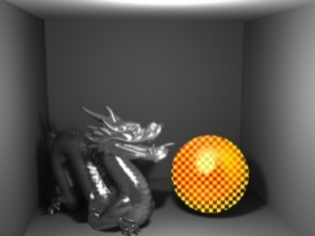
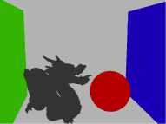
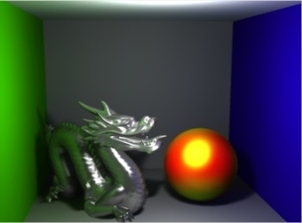
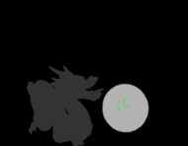
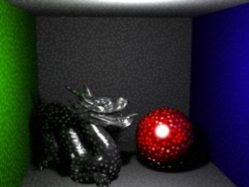
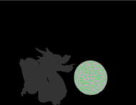
Algorithm overview
Original
User painting
Propagation
Upsampling
Result
Point-based
Optimization
New BRDF
$$L_{i}$$
Original BRDF
$$F_{0}$$
$$F$$
Notes:
An overview of our frame work.
The original scene is represented by point-based representation.
Given some input constraint from the user, the original surface light field is manipulated into the new SLF. Given new SLF and incoming light, we solve for a new BRDF.
Next, the new BRDF is propagated into its neighboring points,
BRDF of the points are then upsampled into the current view. This is used for the final rendering result

Slide 9
Surface Light Field Manipulation - Tools
Manipulated SLF
SLF weight
$$F$$
$$W$$
Input SLF
Tool
$$F_{0}$$
…
…
Notes:
Given an original SLF, tools produces a new one and its weight. The higher the weight put more constraint on preserving outgoing radiance at that direction.
Tools is view dependent. A new surface light field can be a new color, add some color to the old SLF or some smooth and unshapring masking operator.

Slide 10
Point-Based
Input Scene
Notes:
Given an input scene
Solving the problem in the continuous domain is not realistic, we move to the point-based representation of the scene
The scene is represent by a point-based representation where every points have an area that cover the entire scene
Every point is depicted by its incoming light microbuffer and outgoing SLF

Slide 11
Edit Mode – Direct / Indirect
Input Scene
Direct Mode
Indirect Mode
Notes:
Given an input scene.
When a surface light field is edited, for example by a user painting interface, there are 2 modes that can be used.
Direct mode that directly change the surface lightfield of point under the stroke,
Indirect mode modify SLF of points that contribute to the current points.
While direct mode is used to modified the BRDF under the stroke, indirect mode is used to change the surrounding surfaces that cause the new appearance

Slide 12
Optimization
$$n$$
$$ω_{o}$$
g
Input Scene
$$L_{i}$$
BRDF
$$\left\langle , \right\rangle$$
g
$$ω_{o}$$
$$r_{s}$$
Specular color
Glossiness
$$L_{i}$$
$$\left\langle , \right\rangle$$
$$ω_{o}$$
$$r_{d}$$
Diffuse color
$$L_{i}$$
Lambertian
distribution
Notes:
First BRDF are decomposed into diffuse and specular component.
For now we only consider Phong BRDF and Lambertian diffuse. For a certain glossiness g, the brdf can be decompose into specular and diffuse component.
In order to get the outgoing color at a certain direction of the surface light field, get the dot product with the incoming light

Slide 13
Optimization
$$n$$
$$ω_{o}$$
$$ω_{o}$$
g
Input Scene
$$L_{i}$$
BRDF
$$L_{s}(g)$$
$$L_{d}$$
$$\int{g\left(ω_{o}, ω_{i}\right)L_{i}\left(ω_{i}\right) dω_{i}}$$
$$r_{s}$$
$$L_{s}(g,ω_{o},L_{i})$$
$$\int{ \left\langle n,ω_{i}\right\rangle { L}_{i}\left(ω_{i}\right) dω_{i}}$$
$$r_{d}$$
$$L_{d}(L_{i})$$
Notes:
For a certain outgoing direction, in the continuous domain, this can be written as integral in the incoming light

Slide 14
Optimization
New SLF
SLF Weight
$$ω_{o2}$$
$$ω_{o2}$$
$$ω_{o2}$$
$$ω_{o1}$$
$$ω_{o1}$$
$$ω_{o1}$$
$$ω_{o3}$$
$$ω_{o3}$$
$$ω_{o3}$$
$$L_{i}$$
$$L_{s}(g)$$
$$L_{d}$$
F
$$W$$
$$ω_{o2}$$
$$ω_{o3}$$
$$ω_{o1}$$
$$( {−F(ω_{o1}))}^{2}W(ω_{o1})$$
$$r_{ s}L_{s}(g,ω_{o1},L_{i})+r_{d}L_{d}(L_{i})$$
$$\sum_{min}{ }$$
$$( {−F(ω_{o2}))}^{2}W(ω_{o2})$$
$$r_{ s}L_{s}(g,ω_{o2},L_{i})+r_{d}L_{d}(L_{i})$$
$$( {−F(ω_{o3}))}^{2}W(ω_{o3})$$
$$r_{ s}L_{s}(g,ω_{o3},L_{i})+r_{d}L_{d}(L_{i})$$
…
Notes:
First BRDF are decomposed into diffuse and specular component.
For now we only consider Phong BRDF and Lambertian diffuse.
In order to get the outgoing color at a certain direction of the surface light field, get the dot product with the incoming light

Slide 15
Optimization
New SLF
SLF Weight
$$ω_{o2}$$
$$ω_{o2}$$
$$ω_{o2}$$
$$ω_{o1}$$
$$ω_{o1}$$
$$ω_{o1}$$
$$ω_{o3}$$
$$ω_{o3}$$
$$ω_{o3}$$
$$L_{i}$$
$$L_{s}(g)$$
$$L_{d}$$
F
$$W$$
$$W A\left(g\right) x\left(g\right)=W b$$
$$L_{s}(g,ω_{o1},L_{i})$$
$$L_{d}(L_{i})$$
$$F(ω_{o1})$$
$$r_{s}$$
$$L_{s}(g,ω_{o2},L_{i})$$
$$L_{d}(L_{i})$$
$$F(ω_{o2})$$
$$x(g)=$$
$$A\left(g\right)=$$
$$L_{s}(g,ω_{o3},L_{i})$$
$$L_{d}(L_{i})$$
$$b=$$
$$F(ω_{o3})$$
$$r_{d}$$
…
…
$$W=diag(W\left(ω_{o1}\right),W\left(ω_{o2}\right),W\left(ω_{o3}\right),…)$$
Notes:
First BRDF are decomposed into diffuse and specular component.
For now we only consider Phong BRDF and Lambertian diffuse.
In order to get the outgoing color at a certain direction of the surface light field, get the dot product with the incoming light
For fast computation of A(G,L) we need fast look up of specular component at arbitrary glossiness and outgoing direction.

Slide 16
Optimization
$$W A\left(g\right) x\left(g\right)=W b$$
$$A\left(0\right)=$$
$$x\left(0\right)$$
$$L_{s}(0)$$
$$L_{d}$$
$$A\left(1\right)=$$
$$x\left(1\right)$$
$$L_{s}(1)$$
$$L_{d}$$
…
Our solution: Try for a discrete number of glossiness $g$and solve the weighted least square system for $x$
Fast computation of $A\left(g\right)$ !!!
Notes:
Intuitively, A is a matrix that the depend on the glossiness

Slide 17
Precomputed Visibility
ID Texture
$$L_{i}$$
Notes:
Precomputed visibility is used to cache the id of incoming buffer along with position, normal,…
This is used to calculate the incoming light

Slide 18
Preconvolved Radiance
Fast computation of $A\left(g\right)$ !!!
Specular component
Outgoing direction
Glossiness
Scherzer et al: Pre-convolved Radiance Caching, EGSR 2012
Notes:
For fast computation of the matrix A, we need fast look up at arbitrary outgoing direction and different glossiness.
Preconvolve radiance is used for both optimization and rendering of the final results

Slide 19
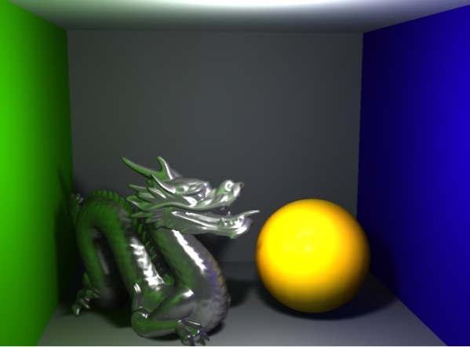
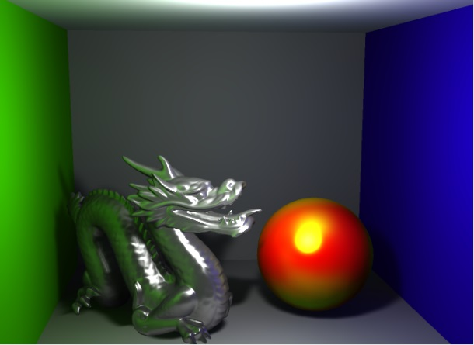
Sparse Optimization
Input Scene
Target
Full solution
Sparse solution
Mixed solution
Notes:
While the original optimize for all components that best fit the artist ‘s prescribed stroke. We find that sometime it might not be the optimal solution. Consider the case where user paint a yellow stroke onto the sphere. The original solution will turn the sphere into yellow diffuse.
We seek a better scheme to understand the artist’s intent, in this case, if we fix 2 components , diffuse and glossiness, and solve for specular color only.
We then try with fixing only diffuse component and solve for both specular and glossiness, this give a result that better match the prescribed stroke.

Slide 20
Edit Propagation
Input Scene
Notes:
-Propagation depend on similarity in term of normal, the original appearance and position.
- This is done to remedy the fact that you have to paint all the point

Slide 21
Upsampling
Input Scene
Notes:
- Upsampling to upsample the result from point-base presentation to the current framebuffer.
-To be able to propagate the manipulation to such details, joint bilateral upsampling in the framebuffer is used. Reconstruction is performed using Radial Basis Function splatting.
-Upsampling is done separately for diffuse, specular and glossiness

Slide 22
Results: Diffuse
Notes:
In this first simple example, the user paints plain green strokes onto the wall.
The system finds a change in reflectance that results in the desired appearance and propagates it to all similar appearance locations of the right wall.

Slide 23
Results: Specular
Notes:
Painting a yellow spot onto the diffuse sphere , will turn it into a yellow highligt. This is achived by changing specular color to green and increasing glossiness.
Painting it white again will change the specular color only.
Drawing a new highlight shape will change the sphere' s glossiness.

Slide 24
Results: Spatially Varying
Notes:
A geometricaly detailled scene with detailled textures and bump maps is edited. Note how both material details are preserved, and manipulations are propagated to regions of similar appearance in the proximity of the stroke.

Slide 25
Results: Enviroment Map Lighting
Notes:
Tuning material under complex illumination such as environment map is difficult.
Here, the user adjusts specularity on the teapot and the apples, again, just by drawing colored strokes.

Slide 26
Results: Indirect Diffuse
Notes:
Manipulation can be performed directly or indirectly.
Here, changing the diffuse indirect light on the ground to green, will change the color of the walls to produce the target appearance at the stroke.

Slide 27
Results: Indirect Glossy
Notes:
The same holds for the glossy floor.

Slide 28
Results: Indirect Caustic
Notes:
Using indirect painting allows to sketch a white caustic shape and the system optimizes for changes of reflectance in other places to produce the caustic, in this case the ring's specularity and glossiness.
We introduct a lock stroke to resolve the ambiguity of the incoming drection and so the ring turns to pure specular.

Slide 29
Results: Unsharp Masking
Notes:
Finally we show a scene with complex spatially varying material.
Our system can be used to turn a physically impossible stylized surface light field (here unsharp masking) into the closest physically possible reflectance reproducing the stylization.

Slide 30
Conclusion and Future Work
Conclusion
A system to infer material from manipulated surface light field
A sparse solver that best fit user’s intent for BRDF editing
Future work
Support other types of BRDF
User study
Extensions to other physically-based rendering such as depth-of-field, motion blur or participating media
Notes:
Proper evaluate to old system

Slide 31
Thank you!
Notes:
1) Thank you very much for your attention.

Slide 32
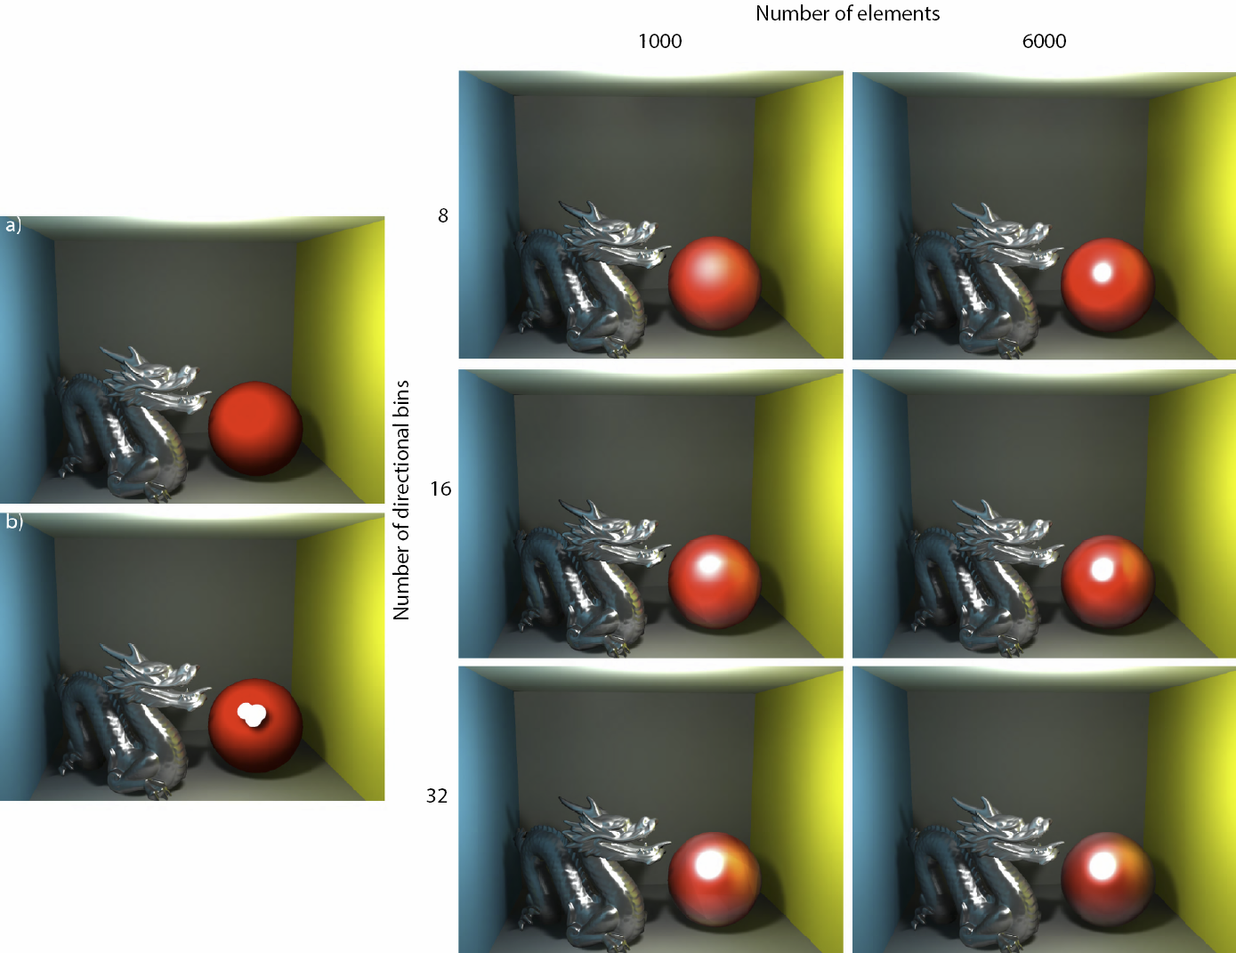
Point Count / Directional Discretization

Slide 33
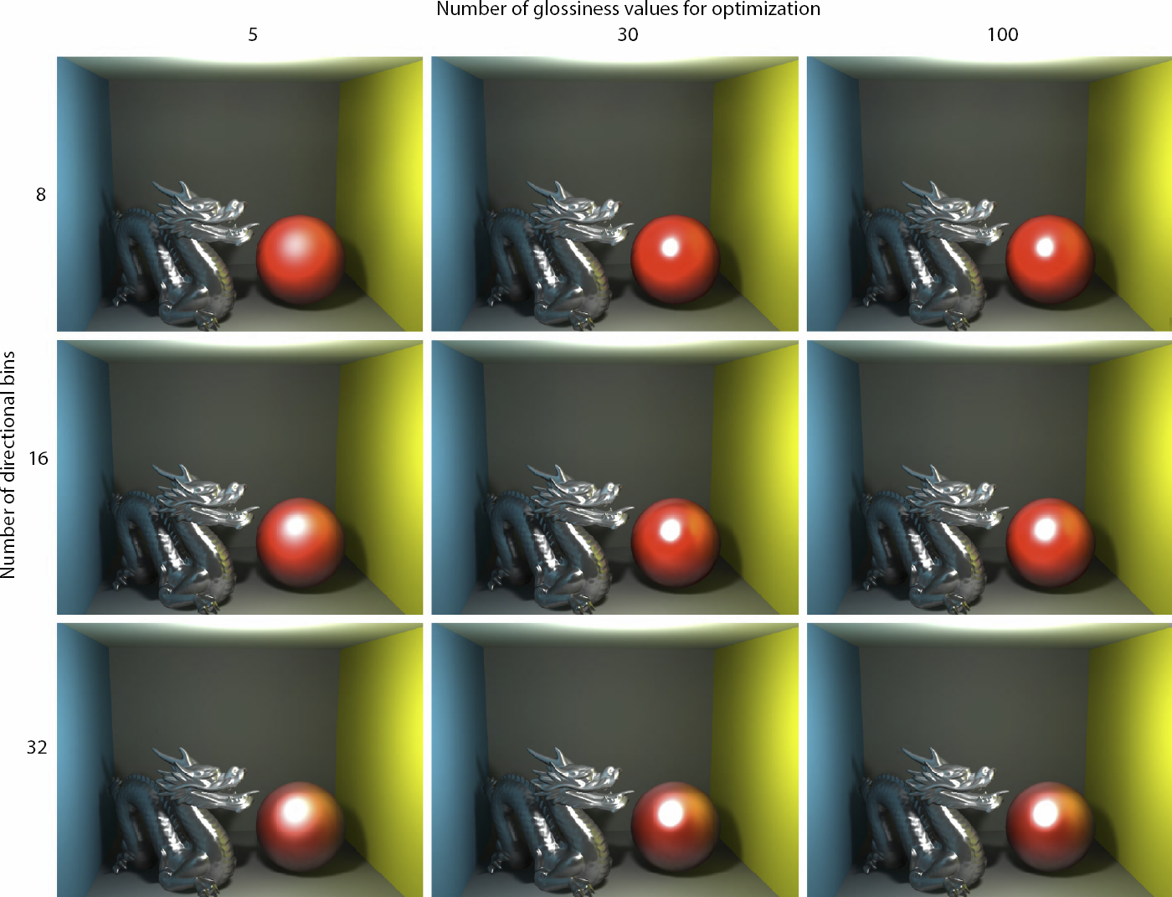
Glossiness Count / Directional Discretization

